Slide 1

MECH 888 Final Project
Ricardo Jacome
Midwest Roadside Safety Facility
University of Nebraska-Lincoln
Final Presentation
04/30/2020

Slide 2
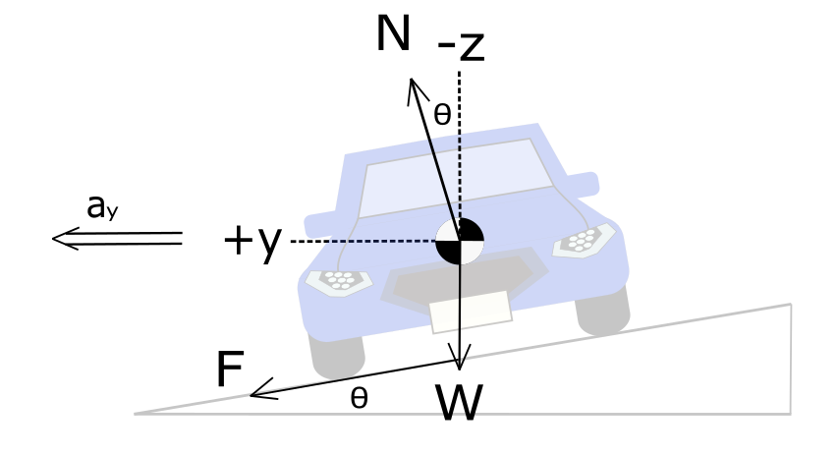
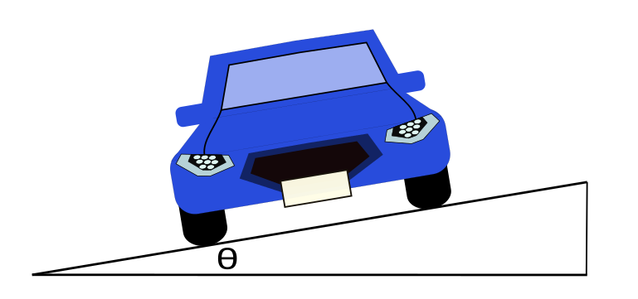
Road Curvature Model Optimization

Slide 3
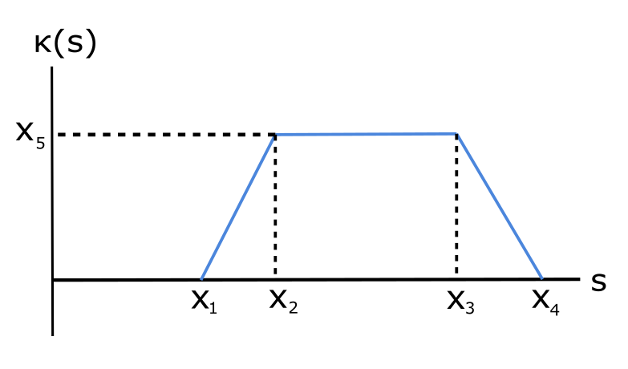

Slide 5






Optimization Algorithm Scheme
Constraints:
Road Design Limits
Road Curvature Decomposition
GPS
Scans
Google Earth
$$κ[s]$$
$$μ,e$$
$$κ_{Opt}(s)$$
Least Squares Optimization
Non-Linear Optimization
$$v_{ideal}$$
$$δ_{ideal}$$
$$κ(s)$$
$$v,δ$$
Analytical Models
Variables:
Vehicle Dynamics Limits
Piece-wise
Polynomial

Slide 6
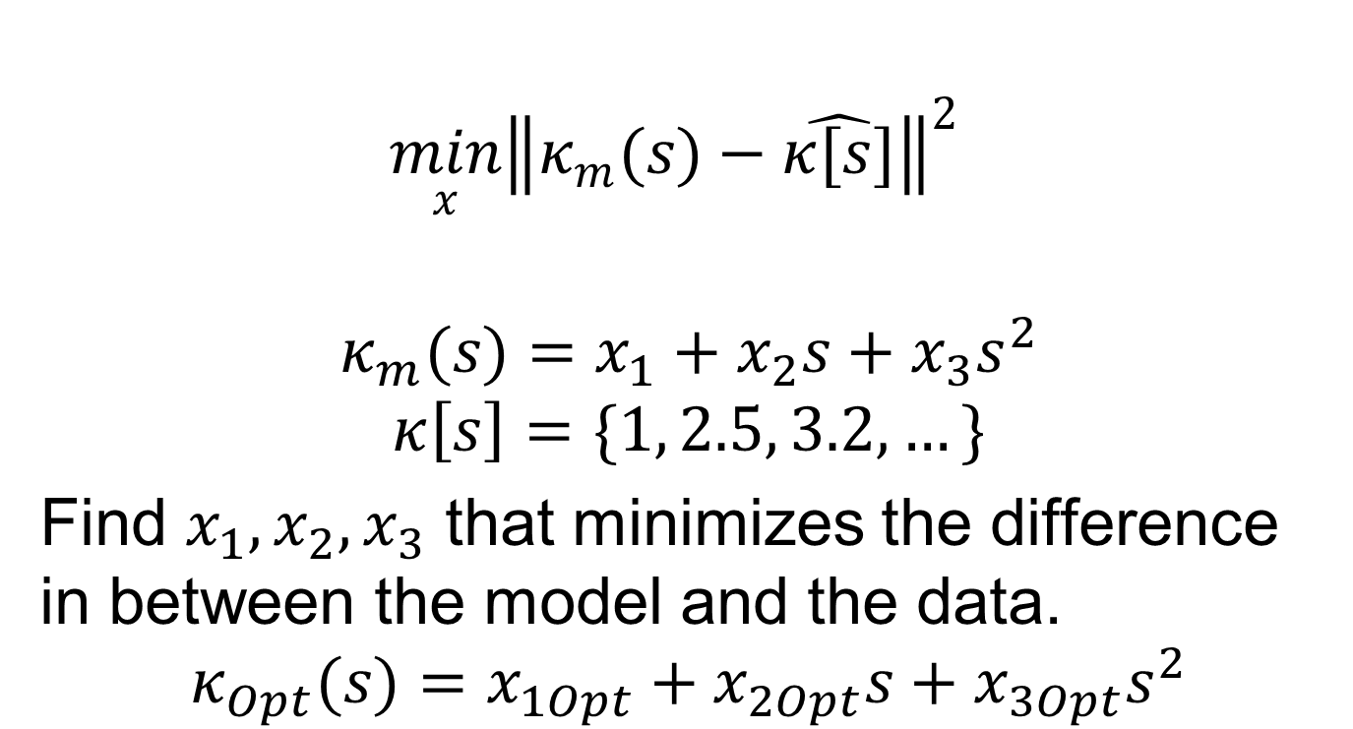
Least Squares Optimization
$$\min_{x}{{\left\|κ_{m}(s)−\hat{κ[s]}\right\|}^{2} }$$
$$κ_{m}(s)=x_{1}+x_{2}s+x_{3}s^{2}$$
$$κ\left[s\right]=\{1, 2.5, 3.2,…\}$$
Find $x_{1}, x_{2},x_{3}$ that minimizes the difference in between the model and the data.
$$κ_{Opt}(s)=x_{1Opt}+x_{2Opt}s+x_{3Opt}s^{2}$$
Back

Slide 7
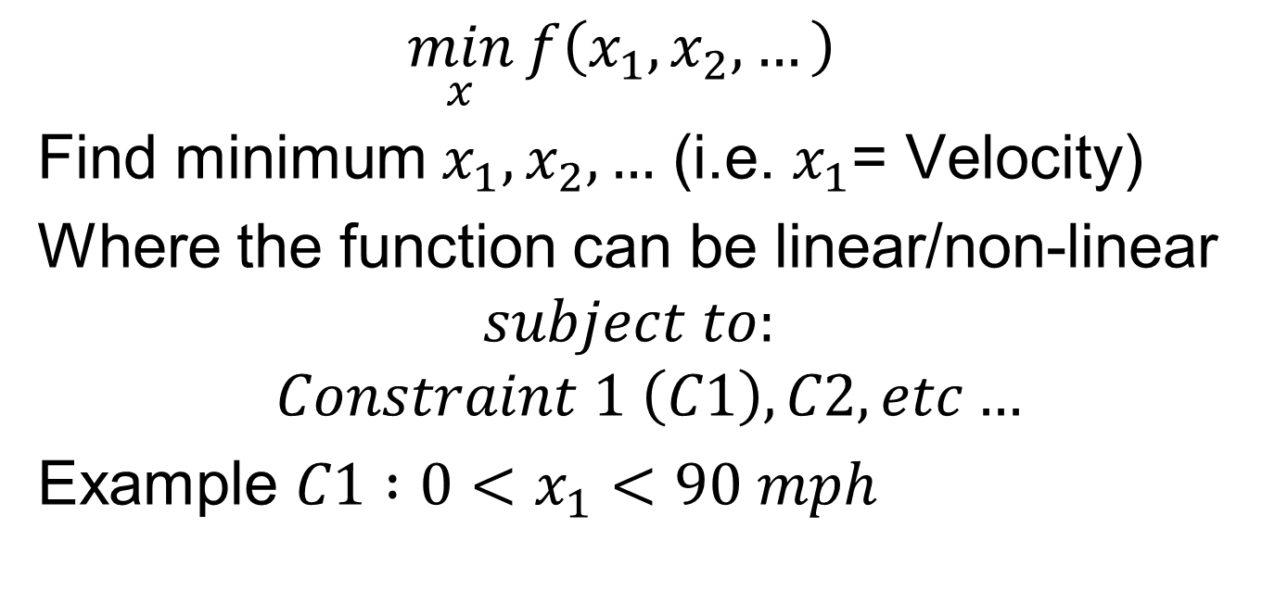
Non-Linear Optimization
$$\min_{x}{f\left(x_{1},x_{2},…\right)}$$
Find minimum $x_{1},x_{2},…$ (i.e. $x_{1}$= Velocity)
Where the function can be linear/non-linear
$$subject to:$$
$$Constraint 1 \left(C1\right), C2, etc…$$
Example $C1 :0<x_{1}<90 mph$
Back

Slide 8

Questions?

